Slide 1
Air Pollution Analysis

Slide 2
Project analysis slide 2
Agenda
EDA
Air Pollution
Dataset Analysis
CONCLUSION
ANALYSIS
DASHBOARD

Slide 3
Project analysis slide 3
Pollutant
RSPM
SPM
SO2
NO2
PM2.5
Respirable Suspended Particulate Matter - particulate matter with diameter of less than or equal to 10 micrometres. They are produced from combustion process, vehicles and industrial sources
Suspended Particulate Matter - such as dust, fumes, mist, and smoke. The concentration of these in and near the urban areas causes severe pollution to the surroundings
Sulphur Dioxed
Nitrogen Dioxed
Particles with an aerodynamic diameter less than 2.5μm

Slide 4
EDA
Getting The Data
Analysing the Data
Data Information
Data description
Checking Duplicates Values
Checking Missing Values
Checking Unique Values
Data Filteration & Modification
Dropping unnessesary column and replacing the texts in “type”
Handling Null Values
Air Quality Index

Slide 5
1. Getting The Data
 | stn_code | sampling_date | state | location | agency | type | so2 | no2 | rspm | spm | location_monitoring_station | pm2_5 | date
0 | 150.0 | February - M021990 | Andhra Pradesh | Hyderabad | NaN | Residential, Rural and other Areas | 4.8 | 17.4 | NaN | NaN | NaN | NaN | 1990-02-01
1 | 151.0 | February - M021990 | Andhra Pradesh | Hyderabad | NaN | Industrial Area | 3.1 | 7.0 | NaN | NaN | NaN | NaN | 1990-02-01
2 | 152.0 | February - M021990 | Andhra Pradesh | Hyderabad | NaN | Residential, Rural and other Areas | 6.2 | 28.5 | NaN | NaN | NaN | NaN | 1990-02-01
3 | 150.0 | March - M031990 | Andhra Pradesh | Hyderabad | NaN | Residential, Rural and other Areas | 6.3 | 14.7 | NaN | NaN | NaN | NaN | 1990-03-01
4 | 151.0 | March - M031990 | Andhra Pradesh | Hyderabad | NaN | Industrial Area | 4.7 | 7.5 | NaN | NaN | NaN | NaN | 1990-03-01

Slide 6
2. Analysing the Data
i. Data Information :
<class 'pandas.core.frame.DataFrame'>
RangeIndex: 435742 entries, 0 to 435741
Data columns (total 13 columns):
# Column Non-Null Count Dtype
--- ------ -------------- -----
0 stn_code 291665 non-null object
1 sampling_date 435739 non-null object
2 state 435742 non-null object
3 location 435739 non-null object
4 agency 286261 non-null object
5 type 430349 non-null object
6 so2 401096 non-null float64
7 no2 419509 non-null float64
8 rspm 395520 non-null float64
9 spm 198355 non-null float64
10 location_monitoring_station 408251 non-null object
11 pm2_5 9314 non-null float64
12 date 435735 non-null object
dtypes: float64(5), object(8)
memory usage: 43.2+ MB
None

Slide 7
ii. Data description :
 | so2 | no2 | rspm | spm | pm2_5
count | 401096.000000 | 419509.000000 | 395520.000000 | 198355.000000 | 9314.000000
mean | 10.829414 | 25.809623 | 108.832784 | 220.783480 | 40.791467
std | 11.177187 | 18.503086 | 74.872430 | 151.395457 | 30.832525
min | 0.000000 | 0.000000 | 0.000000 | 0.000000 | 3.000000
25% | 5.000000 | 14.000000 | 56.000000 | 111.000000 | 24.000000
50% | 8.000000 | 22.000000 | 90.000000 | 187.000000 | 32.000000
75% | 13.700000 | 32.200000 | 142.000000 | 296.000000 | 46.000000
max | 909.000000 | 876.000000 | 6307.033333 | 3380.000000 | 504.000000

Slide 8
iii. Checking Missing Values :
Data columns with null values :
stn_code | 144077
sampling_date | 3
state | 0
location | 3
agency | 149466
type | 5357
so2 | 34632
no2 | 16222
rspm | 40035
spm | 236908
location_monitoring_station | 27303
pm2_5 | 425754
date | 7

Slide 9
v. Checking Unique Values :
Data columns with unique values :
stn_code | 803
sampling_date | 5485
state | 37
location | 304
agency | 64
type | 10
so2 | 4197
no2 | 6864
rspm | 6065
spm | 6668
location_monitoring_station | 991
pm2_5 | 433
date | 5067

Slide 10
3. Data Filteration & Modification
i. Dropping unnessesary column and replacing the texts in “type”:
stn_code, agency & sampling_date this two features is irrelevant to our analysis so let's remove this feature
We are replacing it all the types of locations and getting them down to only 4 following categories:
Residential Area
Industrial Area
Sensitive Area
RIRUO

Slide 11
OUTPUT :
 | state | location | type | so2 | no2 | rspm | spm | location_monitoring_station | pm2_5 | date
0 | Andhra Pradesh | Hyderabad | Residential Area | 4.8 | 17.4 | NaN | NaN | NaN | NaN | 1990-02-01
1 | Andhra Pradesh | Hyderabad | Industrial Area | 3.1 | 7.0 | NaN | NaN | NaN | NaN | 1990-02-01
2 | Andhra Pradesh | Hyderabad | Residential Area | 6.2 | 28.5 | NaN | NaN | NaN | NaN | 1990-02-01
3 | Andhra Pradesh | Hyderabad | Residential Area | 6.3 | 14.7 | NaN | NaN | NaN | NaN | 1990-03-01
4 | Andhra Pradesh | Hyderabad | Industrial Area | 4.7 | 7.5 | NaN | NaN | NaN | NaN | 1990-03-01

Slide 12
ii. Handling Null Values :
As we have seen already that in some features the null values are very few so we can remove those rows directly, it will hadrly effect our overall analysis. Below are the features that we are removing:
location
Date
And also we have seen that there few feature columns having a huge chunk on missing values. By dropping those rows from tha dataset will negetively effect our further analysis, so instead of removing those null values we are going to replace them with the "mean value". Below are the features that we are going to replace values:
so2
no2
rspm
spm
pm2_5

Slide 13
OUTPUT :
 | state | location | type | so2 | no2 | rspm | spm | location_monitoring_station | pm2_5 | date
0 | Andhra Pradesh | Hyderabad | Residential Area | 4.8 | 17.4 | 108.833091 | 220.78348 | NaN | 40.791467 | 1990-02-01
1 | Andhra Pradesh | Hyderabad | Industrial Area | 3.1 | 7.0 | 108.833091 | 220.78348 | NaN | 40.791467 | 1990-02-01
2 | Andhra Pradesh | Hyderabad | Residential Area | 6.2 | 28.5 | 108.833091 | 220.78348 | NaN | 40.791467 | 1990-02-01
3 | Andhra Pradesh | Hyderabad | Residential Area | 6.3 | 14.7 | 108.833091 | 220.78348 | NaN | 40.791467 | 1990-03-01
4 | Andhra Pradesh | Hyderabad | Industrial Area | 4.7 | 7.5 | 108.833091 | 220.78348 | NaN | 40.791467 | 1990-03-01

Slide 14
4. Air Quality Index
AQI: The air quality index is an index for reporting air quality on a daily basis. In other words, it is a measure of how air pollution affects one’s health within a short time period. The AQI is calculated based on the average concentration of a particular pollutant measured over a standard time interval. Generally, the time interval is 24 hours for most pollutants, 8 hours for carbon monoxide and ozone.
We can see how air pollution is by looking at the AQI level:
Good(0 – 50)
Moderate(51 – 100)
Unhealthy(101 – 150)
Unhealthy for Strong People(151 – 200)
Hazardous(201+)

Slide 15
Sub indexes :
Sub indexe of NO2 : As per the Indian Government, safe exposure is 0-80 ug/m3 (24 hours) and as per US-EPA, it is 0-53 ppb (1 hour).
If the value lies between 0 – 40 then we will “NO2*(50/40)” or the value lies between 41 – 80 then we wil “50+(NO2-14)*(50/40)” and so on.
Sub indexe of SO2 : The safe exposure level is 0-80 ug/m3 (24 hours) and 0-75 ppb (1 hour) according to the Indian government
If the value lies between 0 – 40 then we will “SO2*(50/40)” or the value lies between 41 – 80 then we wil “50+(SO2-40)*(50/40)” and so on.
Output :
Output :
Indian AQI | Indian Range for SO2 (ug/m3)
0-50 | 0-40
51-100 | 41-80
101-200 | 81-380
201-300 | 381-800
301-400 | 801-1600
401-500 | 1600+
Indian AQI | Indian Range for NO2 (ug/m3)(24 hours)
0-50 | 0-40
51-100 | 41-80
101-200 | 81-180
201-300 | 181-280
301-400 | 281-400
401-500 | 400+
 | so2 | Si
0 | 4.8 | 6.000
1 | 3.1 | 3.875
2 | 6.2 | 7.750
3 | 6.3 | 7.875
4 | 4.7 | 5.875
 | no2 | ni
0 | 17.4 | 21.750
1 | 7.0 | 8.750
2 | 28.5 | 35.625
3 | 14.7 | 18.375
4 | 7.5 | 9.375

Slide 16
Sub indexe of rspm : If the value lies between 0 – 30 then “rspm*(50/30)” or the value lies between 30 – 60 then “50+(rspm-30)*(50/30)” or the value is between 60-90 then 100+(rspm-60)*(100/30) and so on. If the value is more than 250 then “400+(rspm-250)*(100/130)”
Sub indexe of spm : If the value lies between 0 – 100 then we will “we will use the same present in the dataset” or the value lies between 100 – 250 then “100+(spm-100)*(100/150)” or the value lies between 250 – 350 then “200+(spm-250)” or the values between 350 – 450 then “300+(spm-350)*(100/80)“. If the value is more than 450 then “400+(spm-430)*(100/80)”
Output :
 | rspm | rpi
435734 | 148.0 | 122.666667
435735 | 131.0 | 117.000000
435736 | 140.0 | 120.000000
435737 | 143.0 | 121.000000
435738 | 171.0 | 130.333333
Output :
 | spm | spi
435734 | 220.78348 | 180.52232
435735 | 220.78348 | 180.52232
435736 | 220.78348 | 180.52232
435737 | 220.78348 | 180.52232
435738 | 220.78348 | 180.52232

Slide 17
Output :
 | date | state | si | ni | rpi | spi | AQI
0 | 1990-02-01 | Andhra Pradesh | 6.000 | 21.750 | 109.61103 | 180.52232 | 180.52232
1 | 1990-02-01 | Andhra Pradesh | 3.875 | 8.750 | 109.61103 | 180.52232 | 180.52232
2 | 1990-02-01 | Andhra Pradesh | 7.750 | 35.625 | 109.61103 | 180.52232 | 180.52232
3 | 1990-03-01 | Andhra Pradesh | 7.875 | 18.375 | 109.61103 | 180.52232 | 180.52232
4 | 1990-03-01 | Andhra Pradesh | 5.875 | 9.375 | 109.61103 | 180.52232 | 180.52232

Slide 18
Project analysis slide 5
Analysis
Average Of NO2
Average Of SO2
Average Of spm
24.85
9.97
100.50
Nitrogen Dioxed
Sulphur Dioxed
.
Suspended Particulate Matter
Average Of rspm
Average Of AQI
98.79
188.58
Respirable Suspended Particulate Matter
Air Quality Index

Slide 19
At 1995 the value of so2 is 26.00 and at 2003 the value of so2 is 6.55
West Bengal as no2 value as 59.07 and Delhi as no2 value as 53.48 it also has rpsm value as 196.63 and the Maharashtra as rspm value as 101.47

Slide 21
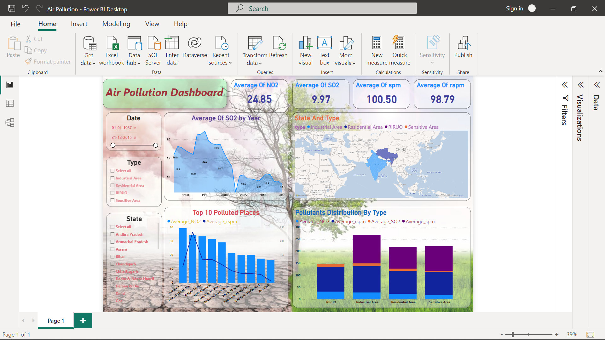
Dashboard

Slide 22
Conclusion
As we can see that at West Bengal, Delhi, Haryana & Rajasthan high AQI values and at the industrial area the air pollution is high compared to other types (considering all the types). While comparing between SO2 & NO2, NO2 is high in both industrial area and RIRUO.
Key influencers :
NO2 :– In state “West Bengal, Delhi, Jharkhand, Maharashtra, Rajasthan” , In types the industrial area and the top segment is West Bengal having average value of 58.68 it’s more the overall average 24.85.
SO2 :– In state “Jharkhand, Maharashtra, Gujarat” , In types the industrial area and the top segment is Maharashtra having average value of 16.77 it’s more the overall average 9.97

Slide 23
Thank You

